Slide 1
G SESHANTH
NM ID: au412721205043
Final Project

Slide 2


PROJECT TITLE
VEHICLE NUMBER PLATE RECOGNITION

Slide 3
PROJECT OVERVIEW
Number Plate recognition, also called License Plate realization or recognition using image processing methods is a potential research area in smart cities and the Internet of Things. An exponential increase in the number of vehicles necessitates the use of automated systems to maintain vehicle information for various purposes.

Slide 4
AGENDA
This is **"SSD"** algorithm based **Tensorflow Object Detection** model.
It can detect the number plates of vehicle.
For text extraction **"EasyOcr"** model is used
Based on the number plates it will give corresponding state (from India) of that vehicle.
This is flask based webapp which you can deploy it on pivotal cloud.
For accurate results Image size should be minimum of **800 x 600**.
Supported image file formats are **".PNG"**,**".JPG"**,**".JPEG"**.

Slide 5
TECHNOLOGY USED IN THIS PROJECT
I have developed this project using the below technology
HTML : Page layout has been designed in HTML
CSS : CSS has been used for all the designing part
JavaScript : All the validation task and animations has been developed by JavaScript
Python : All the business logic has been implemented in Python
Flask: Project has been developed over the Flask Framework

Slide 6
PROBLEM STATEMENT
1.Detection Accuracy: Design and implement a deep learning model capable of accurately detecting vehicle number plates in images or video frames under various environmental conditions such as varying lighting, weather, and occlusions.
2.Character Recognition: Integrate optical character recognition (OCR) techniques to extract alphanumeric characters from the detected number plate regions, enabling automatic reading of license plate numbers.
3. Real-time Processing: Optimize the model and algorithms for real-time performance, enabling efficient processing of video streams from surveillance cameras or live feed sources.
4. Scalability: Ensure the system's scalability to handle a large volume of vehicle images or video streams, accommodating diverse vehicle types, plate formats, and viewing angles.
5. Privacy and Security: Implement privacy measures to protect sensitive information captured by the system, adhering to data protection regulations and ensuring secure handling of vehicle registration data.
6. User Interface: Create an intuitive user interface for system configuration, monitoring, and interaction, facilitating easy deployment and management by end-users such as law enforcement agencies, parking management authorities, or private security firms.

Slide 7
THE END USERS
The end users of the vehicle number plate detection system could include various entities and organizations involved in law enforcement, traffic management, security, and related fields. Here are some potential end users:
1. Law Enforcement Agencies: Police departments and law enforcement agencies can use the system for automatic detection of vehicle number plates to enforce traffic laws, identify stolen vehicles, and investigate criminal activities.
2. Parking Management Companies: Parking operators and management companies can benefit from the system to monitor parking lots, enforce parking regulations, and automate payment processes.
3. Security Firms: Private security firms and facilities management companies can deploy the system for surveillance purposes, ensuring the security of premises and monitoring vehicle access.
4. Border Control and Customs: Border control agencies and customs authorities can employ the system for monitoring vehicle movement at border crossings, ports, and customs checkpoints.
6. Toll Collection Agencies: Organizations responsible for toll collection on highways and expressways can use the system for automated tolling, reducing manual intervention and improving efficiency.

Slide 8
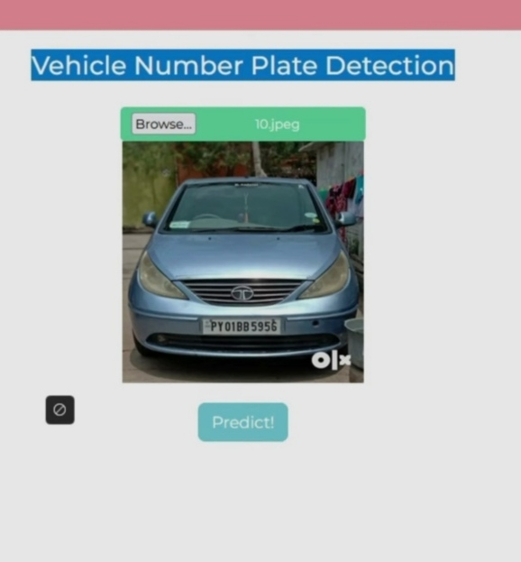
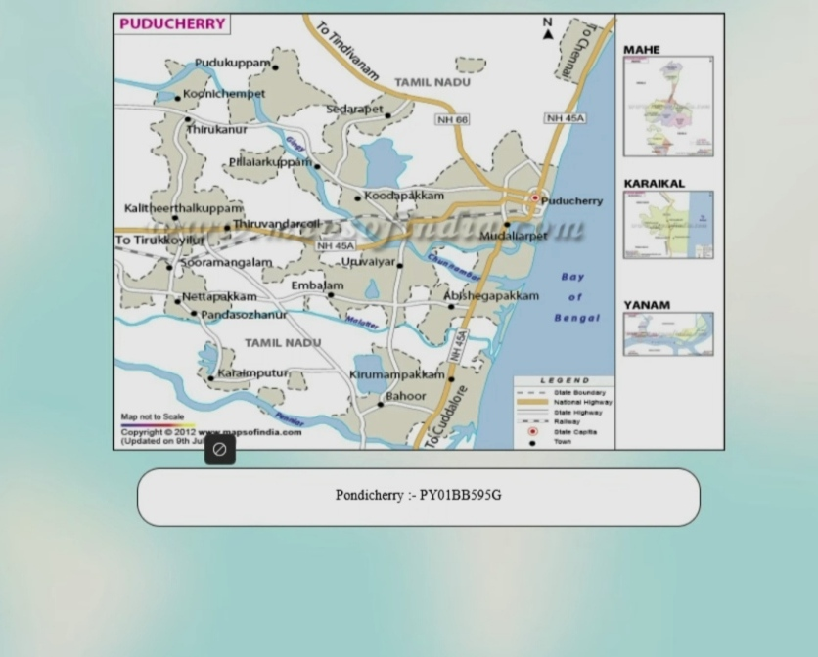
PROJECT SOLUTION

Slide 9
THE WOW IN THE SOLUTION
Accuracy and Efficiency: The solution achieves high accuracy in detecting vehicle number plates under various environmental conditions, including challenging lighting, weather, and occlusions. Its efficient processing capabilities enable real-time detection and tracking of vehicles, ensuring timely responses to events.
Intelligent Features: Integration of advanced techniques such as region proposal networks (RPN), non-maximum suppression (NMS), and optical character recognition (OCR) enhances the system's intelligence and functionality. These features enable precise localization of number plates, accurate character recognition, and effective post-processing for refining detections.
User-Friendly Interface: The intuitive user interface makes the system easy to configure, monitor, and interact with, allowing end users to deploy and manage the solution with minimal training or technical expertise.

Slide 10
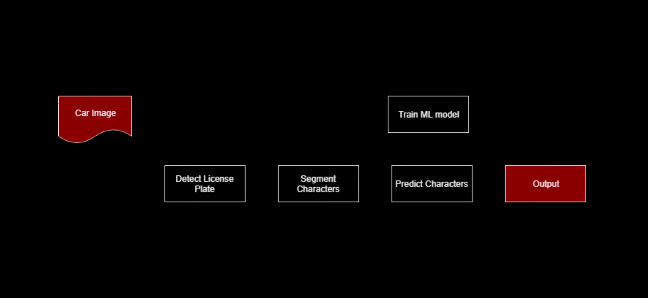
MODEL ARCHITECTURE
VEHICLE NUMBER PLATE RECOGNITION

Slide 11
CONCLUSION
The vehicle number plate detection project has successfully developed a robust and efficient system leveraging deep learning techniques to address the challenge of automatic number plate detection. Through the implementation of a sophisticated model architecture and intelligent algorithms, the system achieves high accuracy, scalability, and user-friendliness, making it suitable for a wide range of applications in law enforcement, traffic management, security, and more.

